Slide 1
Martin’s Point Management System:
Understanding Collaborative Care Visits
12/17/2012 – 12/20/2012

Slide 2








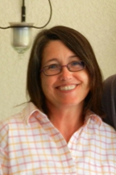
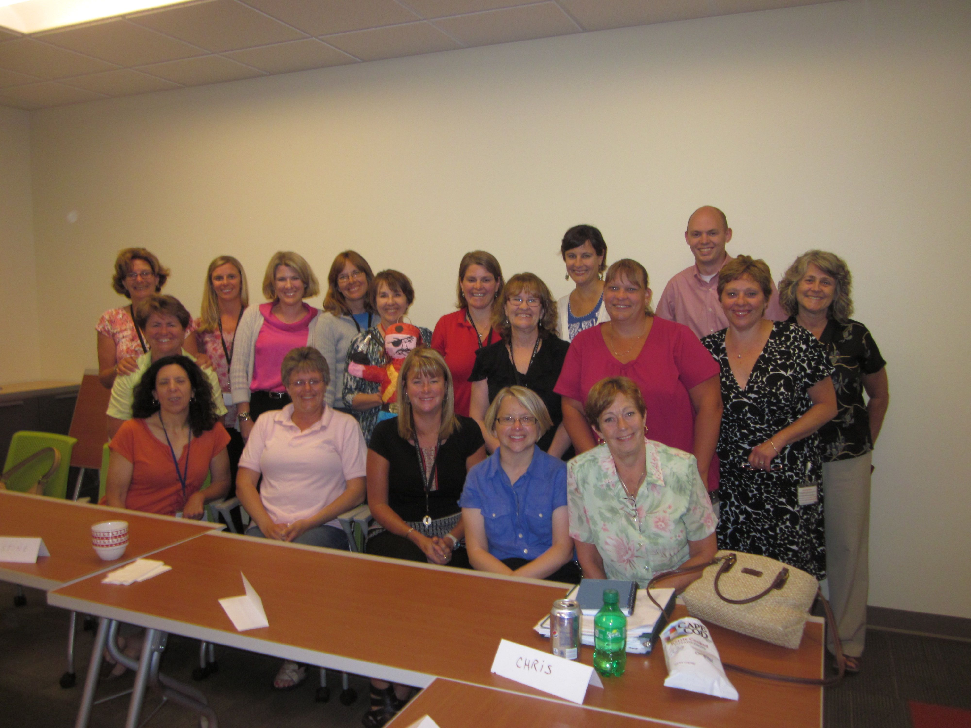
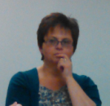

The Team
Team:
Alain Montegut, VP primary care development
Charlie Berger, PProvider Bangor
David Halbert, Provider, Bangor
Ellen Gagnon, SR program manager
Jessica Little, Clinical program development, HProvider
Jill Devereux, RN pop health nurse (PHC)
Molly Stevens, RN specialty nurse (Bangor)
Linda Mullen, RN specialty nurse (Bangor)
Linda Turner, PSR Bangor/PI
Paula Eaton, PA
Terry Baldwin – Office of MPMS
John Kim – JKA
Special Thanks to:
Bangor Team
Donna Gartland

Slide 3
Professional and Staff Relations
Being a superior service organization is a total team effort. While we recognize different levels of skill and responsibility in our organization., we do not support (recognize) differences in status between professional (Provider, NP, RN) and management support staff. Indeed, these lines will become more blurred as the entire office team becomes more involved in achieving superior clinical results

Slide 4
Charter
Problem Statement:
The practice processes for population health and disease management, and coordination of health place case management resources vary by location, resulting in no standard Care Model for the delivery system.
  As part of our Care Model development and in support of achieving the Triple Aim, we intend to provide or arrange case management, disease management and continuity of care support for our patients. Currently, our approaches vary across the sites.
  In order to achieve quality outcomes and reduction of medical expense, we will develop standard approaches that can be incorporated into the practice flow for the DS, leveraging the prior care management work and incorporating the reimbursable approach taken in Bangor as the jumping off point.

Slide 5
Charter
Desired State:
Design and document a recommended approach and processes for identifying, stratifying and managing health and medical expense needs of patients who are in need of case and chronic disease management, that meet national standards (e.g. BTE/PCMH), appropriately align with revenue generation opportunities, knit-into our patient flows and is integrated with the medical expense management system in the DS.

Slide 6
Charter Objectives:
Review the current state in Bangor for chronic care/disease management, including the use of collaborative office visits
Understand the effectiveness of the model (outcomes, gaps in care, cost of care/med expense, patient satisfaction, etc) and the costs.
How does this model align with the NCQA PCMH standards and identify gaps
Review other related work to date, specifically the Care Management
Understand how the Collaborative Care pre visit aligns with the work currently performed in other sites by Population Health nurses
Understand how the Collaborative care process leverages existing tools including Population Manager, Provider Reporting and Medical Expense Tool.

Slide 7
Charter Objectives (continued)
Consider impacts of risk-sharing plans (USFHP, Cigna, Aetna, etc) and/or any additional reimbursement opportunities
Consider best practice from other health systems (eg Bon Secour, Group Health)
Develop clear criteria for patient selection for the program and factors to estimate the size of the applicable patient population within a panel.
Develop and document a recommended best practice for identifying, stratifying, and managing the health need of our patients
Develop and document a recommended best practice for identifying, stratifying, and managing the care and medical expense needs of chronic patients.
Consider how we can effectively integrate key collaborative care components into existing practice processes.

Slide 8
What do we mean by “Collaborative Care Visit (CCV)”
The Collaborative Care Visit, based on a model developed by Dr. Ed Wagner for the care of chronic disease patients, is designed to provide a care team approach to the office visit when additional clinical face-time with the patient for history taking, education and/or counseling are of high value.
The model enables a longer patient visit (45-60 minutes) with a Collaborative Care Nurse (RN)*, where the Provider is engaged in the final phase of the visit including the physical exam and update of the care plan (15 minutes).
Success of this approach relies on coordination and pre-planning by the RN including a pre-visit huddle with the Provider. The RN also follows up with the patient between visits via telephone for additional support as needed.
This approach may be appropriate for a variety of situations: new patient intake, patients dealing with complex conditions (ex: cancer), etc. Currently, our primary focus for this model is chronic disease patients, where self care is paramount.
*In Bangor, these nurses are referred to as “Specialty Nurses”. Across MPHC, evolution of the “Pop Health Nurse” position is envision to include care delivery. Both titles have other nuances – for the purpose of this presentation, we will use “Collaborative Care Nurse” or RN.

Slide 9
Bangor Area and Bangor Patient Panels
Strong leadership (Clinical & Operational)
  On the same page
  Common vision
Strong sense of accountability (and processes/indicators to support)
Key process(es) defined, communicated and understood
Patient centered (processes, leadership, staff)
Long Tenure providers → higher acuity patients
Strong sense of trust, commitment to patients & commitment to each other
High cost region (hospitalization)
Process focused to engage staff at highest degree of licensure
High degree of shared responsibility (e.g. providers take direction from PSR)
Common language (collaborative care, clinical huddle, huddle..)
Training process well defined (proficiency, competency and accountability)
Systems thinking ‘mindset’ (what is the process vs who did what)

Slide 10
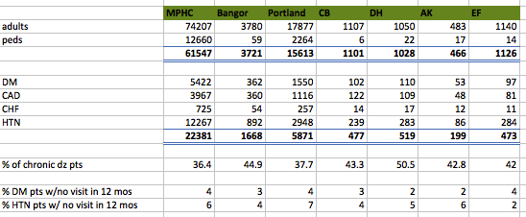
Bangor Patient Population
Providers
Evaluation of patient panels show that Bangor has 44.9% of their patients with Chronic conditions (MPHC = 36.4%)
* Data from PopulationManager™ (12/10/12)

Slide 11
Understanding our metrics (and Collaborative Care)
Collaborative care results are a represented by a series indicators:
  Quality Outcomes: → ⬆ NCQA, ⬆ CMS
  Financial: → RVU (Revenue) vs Cost analysis
                ⬆ RVU/provider per hour
                ⬆ RVU/visit
                IPOP contribution
  Med Expense: → ⬇ ED visits, ⬇ In patient costs
  Patient Satisfaction: → ⬇ patient loss = ⬆ Growth (revenue)

Slide 12
Financial: Income performance
 | Bangor | MPHC AVE | Benchmark (11 months prorated)
Net Income/provider | ($65K) loss | ($74K) loss | MGMA: $447 profit
Expense/provider | $320K | $440K | Not Available
Revenue/provider | $255K | $367K | Not available
RVU/physician | 9106 | 9198 | MGMA: 10,007
Revenue/patient | $324 | $309 | MGMA: 182
Panel size | 3700 |  | target panel = 5400
Panel/PC contact hour* | 970 | 1073 | MGMA: 2147
*taken from November PMI report
of the 4 providers at Bangor is currently at 25% of target panel size. This new provider ramp up impacts all ‘per provider’ measures by 17% (25% of 75%)

Slide 13
Financial: Pathway to breakeven (Another look)
When building a panel for a new provider, it takes time to fill his/her panel. Currently our new provider is at ~25% capacity. This analysis ‘backs out’ the cost of the provider (and support) and impact to financials (“…pathway to breakeven…”)

Slide 14
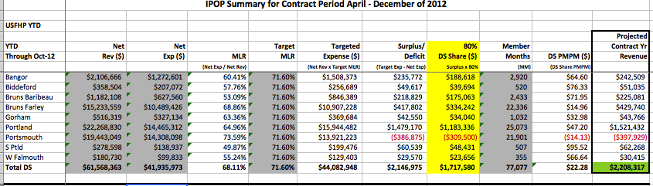
Financial: IPOP Dollars
USFHP:
  Bangor represents 3.8% of the member months
  Bangor is contributing 11% of the IPOP dollars
    Bangor IPOP $ 188, 618
    MPHC IPOP $ 1,717,580
CCV Visits and IPOP contribution (USFHP)
Bangor represents 3.8% of the USFHP member months, yet contributes 11% of the IPOP dollars

Slide 15
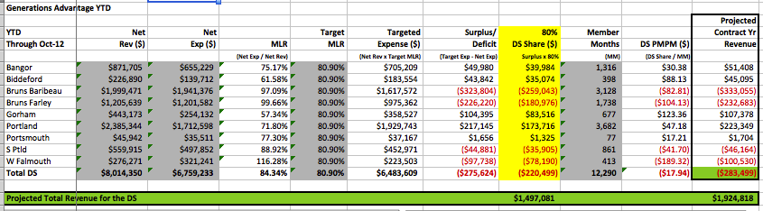
Financial: IPOP Dollars
GA:
  Bangor represents 10.7% of the member months
  Bangor is contributing $39,984 of IPOP dollars
  vs
  Overall total of –($220,499)
CCV Visits and IPOP contribution (GA)
Bangor represents 10.7% of the USFHP member months, yet contributes $39,984 of the (-$220,499) IPOP dollars

Slide 16
Financial: Collaborative Care Visit (RVU’s and Provider Productivity)
Schedule (Provider Productivity):
Traditional Care Model (Physician performs 75+% of clinical visit)
Patient Type RN Time Provider exam time RVU Generation
Chronic Patients 15 min 30 - 45 min 2.71 RVU (80%) 99214
3.66 RVU (20%) 99215
Collaborative Care Model (Physician performs <25% of clinical visit)
Patient Type RN Time Provider exam time RVU Generation
Chronic Patients 30-45 min 15 min 2.71 RVU (40%) 99214
3.66 RVU (60%) 99215
In the Collaborative Care model, the emphasis is on the pre visit work conducted by the Collaborative Care Nurse. It is this up front work, that enables
Providers to perform Chronic visits in 15 minutes (Productivity, Capacity, Access)
RN/Providers to maximize care provided (education, lab reviews, ‘between visit’ clinical reviews)
Optimize coding (revenue)

Slide 17
Financial: Does the math work?
Visit | Visit Time | RVU | Revenue @ $37/RVU | Total Rev/provider hr | Comments
Traditional Care Model | 30 min | 2.9 RVU 20% - 2.71 80% - 3.66 | $107.30 | $214.60 | Minimal/no pre visit work. 95% of patient care completed by provider. Emphasis on having minimal clinical staff to support Provider
Collaborative Care | 15 min | 3.28 RVU 40% - 2.71 60% 3.66 | $121.36 | $485.44 | Pre visit work completed by Collaborative Care RN. Clinical huddle completed by Provider-RN. RN has appropriate time for clinical analysis, records review, patient education… etc to optimize visit (and coding)
Additional revenue/hr due to Collaborative Care = $270.84
RN Salary = $70,000
Target 8 chronic visits/day (2 Provider hrs) = $541.68 ($270.84/hr x 2 hrs)
# days required to break even = 129 days (26 weeks)
Incremental $ @45 weeks (19 weeks x $541.68/day x 5 days) = $51,459.60

Slide 18
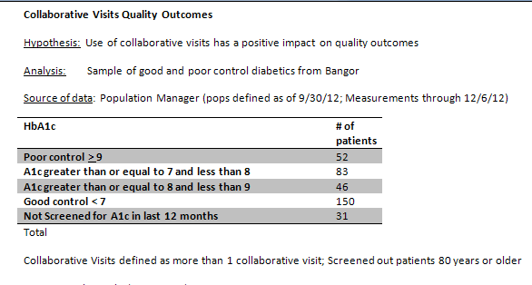
Quality:
Question: What does the data show re Diabetic patients? The team looked at:
202 patients total
52 Patients in poor control
150 patients in good control

Slide 19
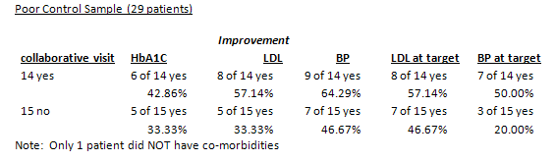
Quality:
Collaborative care visits
Traditional care visits
Question: Did the patients (in good control) in the CCV model show improvement to NCQA core quality measures?
Of 29 patients in ‘poor’ control
  14 were in the Collaborative care model
  15 were under the Traditional care model
In all 5 categories (A1c, LDL, BP, LDL @ target, BP @ target), the patients in the Collaborative care model outperformed the traditional care model by between 23.6% & 150%
Of the 29 patients studied, 28 had multiple co-morbidities

Slide 20
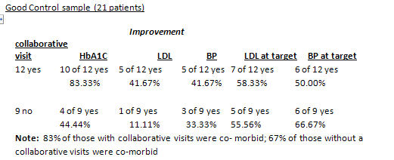
Quality:
Collaborative care visits
Traditional care visits
Question: Did the patients (in poor control) in the CCV model show improvement to NCQA core quality measures?
Of 21 patients in ‘good’ control
  12 were in the Collaborative care model
  9 were under the Traditional care model
In 4 out of 5 categories (A1c, LDL, BP, LDL @ target, BP @ target), the Collaborative care model outperformed the traditional care model by between 5.1% & 380%
9 of the 12 patients in Collaborative Care had multiple co-morbidities (83%)
6 of the 9 patients in Traditional Care had multiple co-morbidities (67%)

Slide 21
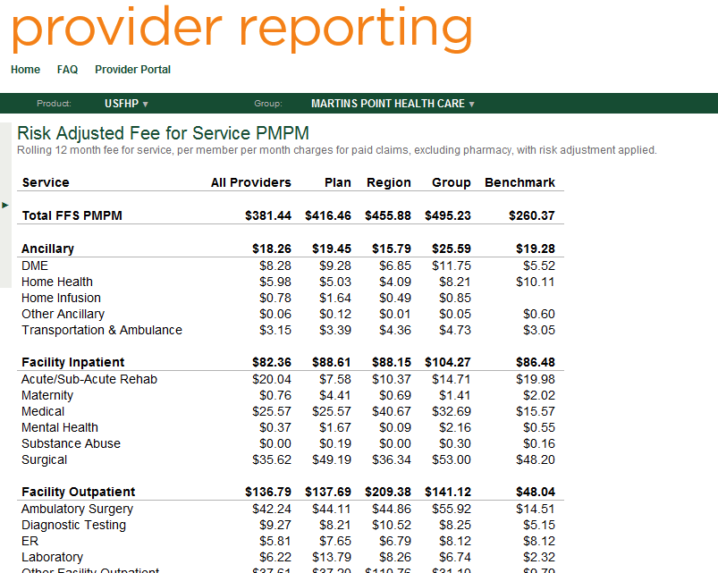
Med Expense:
Question: Does the CCV model result in lower Medical Expense?
Bangor
Total FFS pmpm (23.0%)
  Bangor pmpm $381.44
  MPHC pmpm $495.23
ER pmpm (28.4%)
  Bangor pmpm $5.81
  MPHC pmpm $8.12
Facility Inpatient (21%)
  Bangor pmpm $82.36
  MPHC pmpm $104.27
* Provider reporting data is risk adjusted
GA data shows the Bangor area to have notably higher costs of care relative to other areas in the state.

Slide 22
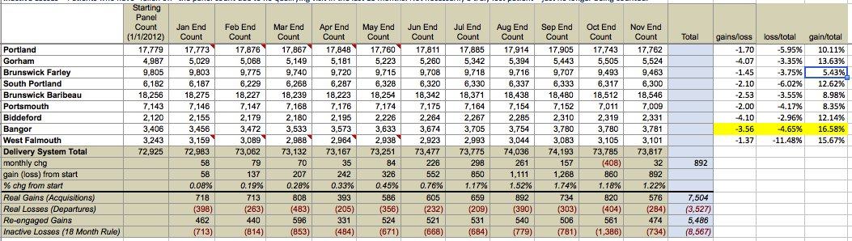
Patient, Provider and Staff satisfaction:
Question: How does Bangor patient retention compare against other MP practices?
Bangor:
Ytd gained 627 patients
Ytd loss 176 patients
Net gain of 375 (Best Gain vs Loss ratio in MP, in one of the most competitive markets as Bangor region has many options for primary care)
100% provider satisfaction
100% staff satisfaction
92% patient satisfaction

Slide 23
Understanding Collaborative Care
What is “Collaborative Care?”
Collaborative Care is a care team approach (primarily RN/Provider) that:
  Focuses on our most Chronic patients
  Expands upon the traditional population health RN role
    Patient pre visit activity (Labs, tests, telephonic support..)
    Integrates RN skills into the patient visit (RN conducts majority of patient visit)
    Collaborates RN/Provider roles during the patient visit
    Enables RN to appropriately care (and code) for the most Chronic of our patients
Enables providers:
  To conduct more Chronic visits/hour (30 and 45 minutes visits can now be completed in 15 provider minutes)
  To appropriately generate more RVU’s/visit (services and coding)
Key Points:
In the traditional care model (i.e. FFS driven) a primary focus is on staffing ratios. The collaborative care model is dependent on key RN activity pre visit.
If one measures “staffing ratios” in a shared risk environment, we will in essence prevent any investment in (1), Population health, (2) “working at the top of one’s license” and (3) Collaborative care

Slide 24
Understanding Collaborative Care
What is “Collaborative Care?”
Enables providers (continued):
  To spend more personal time with patients resulting in:
    Quality outcomes: For collaborative care patients, 9 of 10 key diabetic measures demonstrated higher improvement vs traditional care
    Revenue/Production: The Collaborative care model yields more
      RVU’s/provider than traditional office visit (revenue/visit)
      Chronic provider visits/hr (Capacity & Access)
    Patient Satisfaction: Patient retention rate amongst top 3 in MPHC
    Employee satisfaction: Staff and provider satisfaction scores of 100%
The Collaborative Care Visit (CCV) model utilizes additional Collaborative Care RN resources to (1) enhance clinical care provided (PCMH), (2) remove pressure on Provider schedules (‘15 vs 30’ = increased capacity = improved access), (3) fundamentally change the (practice) financial model for chronic patients (more visits/Provider and more RVU’s/visit)

Slide 25
Collaborative Care: Roles & Responsibilities
PopHealth/Specialty RN:
  Between visit coordination, monitoring & support
  Previsit care & coordination
  Prepare Patient (medical, environmental & emotional) summary for Clinical Huddle (Provider & RN)
  Lead Clinical huddle with Provider
  Conduct 75% of the clinical visit
  Appropriate Coding of visit (99215, 99214. 99213)
Provider:
  Manage patient care
  Conduct 25% of the clinical visit
  Maximize value added time with patient (15 min visit = Higher quality visit for patient)
The Collaborative Care Visit (CCV) model works because of the collaborative nature of patient care, patient preparation and patient visits.
The CCV model enables Provider and Pop Health/Specialty RN to both work at the top of their licensure
If either does not perform their role, the end result will be a traditional visit (30-45 mins) with added cost (Pop health/specialty RN)

Slide 26
Collaborative Care
  Staffing ratios: The Collaborative Care model is designed to utilize dedicated RN’s (emphasis on pre-visit work and Collaborative patient visits).
  Pre visit work enables:
    ‘30’ minute provider visits to be completed in 15 minutes → RVU, access, capacity, revenue, quality time
    Proper planning (i.e. Pre visit work & Clinical huddle) enables:
      Quality of care
      Appropriateness of care
      Patient Satisfaction
      RN Satisfaction
      Provider Satisfaction
      ⬆ RVU/patient (Education, lab review, chart review…)
    Pre visit work + collaborative visit (Provider/Nurse) enables ⬆ attention/communication between Provider & Patient
The Collaborative Care RN is the key to the CCV model. Without proper preparation, coordination and communication (RN → Provider and Provider → RN), the care model cannot support 15 minute Provider visits

Slide 27

Collaborative Care: Key Points
Outcomes centered care model
Patient experience centered model
High staff/provider satisfaction
Designed to optimize and leverage provider time and energies
Built on foundation of care team (Nurse, CS, PSR) preparing information, patient, charts… etc prior to patient visit
Process designed with knowledge sharing in mind: Systems, standard work, clinical huddles
Impact of collaborative care model show beyond financials (e.g. patient satisfaction, patient loss, med expense…)
  150-200 active cases/care management (3500)
  Patients nominated into collaborative care program
  Care team work pre visit provides structure for coding accuracy and compliance accuracy (not 100% on shoulders of providers)

Slide 28
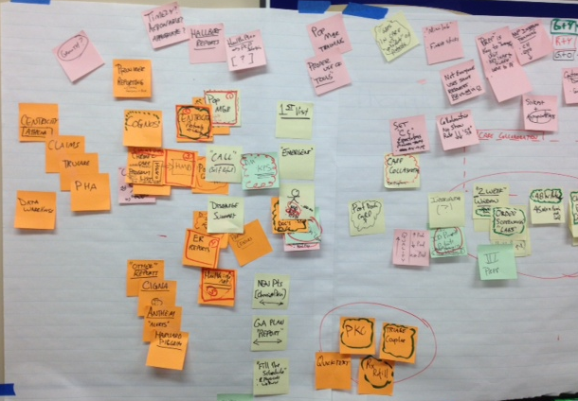
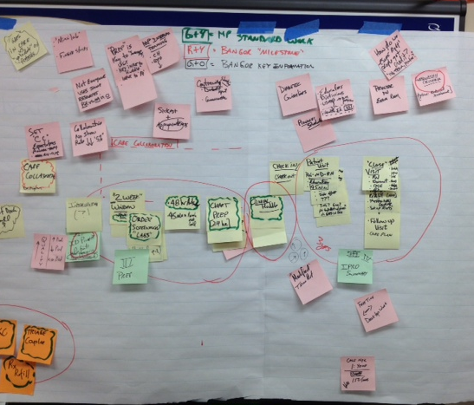
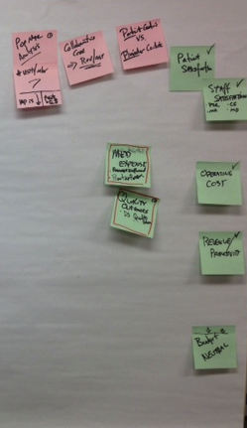
Process overview
Data, Tools & Information
Pre visit Preparation
Clinical Huddle
Collaborative Visit
Collaborative Visit:
Nurse driven prep
Leverage provider time
(15 min vs 30 min)
Collaborative care
Key information and Tools and training on the tools is key to success
HealthInfoNet (HIN)
Centricity
Practice Census
PMP
IPRO
Pre-visit work (2 weeks prior, 48 hrs prior) is the key to successful and effective Collaborative Care visit. When preparation is done well we prevent unnecessary multiple visits, missed labs .
Clinical Huddle (Daily):
Nurse-Provider have common understanding of patient condition and daily objectives. Clinical huddles create the opportunity for Increased:
Patient satisfaction (quality time)
Visits (30 & 45 min provider visits completed in 15 min)
Access (Capacity)
RVU/visit
Revenue >> cost

Slide 29
Collaborative Care Model: Key steps in the process
CCV Candidate selection (and graduation)
  Provider/Staff nomination
  Multiple co-morbidities
  Key environmental/social factors
  Introduce HProvider input (IPRO: predictive modeling)
Visit preparation
  Key to success of the Collaborative care “visit”
  Nurse driven process
  Sets stage for coding opportunities (99214, 99215)
  Enables ‘high velocity’ flow of patients and ‘high productivity’ of providers
Visit
  Patient centered visit
  Collaborative care approach (Nurse coordinated)
  Provider visit target 15 min (vs 30 min)

Slide 30
Keys to success
Practice leadership with full care team buy in (Providers, Nurses, Clinical Support & PSRs)
Trust in the system and between the team members – established through:
  Clear and transparent training program that includes deliberate feedback to develop and refine competencies;
  Protocols/standards, phased implementation plan
Appropriate room assignments & capacity to enable nurse/provider effectiveness
Understanding that staffing model in the future will be different than the staffing model of the past.
Training for the specialty nurse in:
  Case management
  Motivational interviewing
  CPOE
  Pop Manager
  Coding
  HIN
Recognize the visit notes are interdisciplinary tools: Provider feedback and guidance is needed to ensure the nurses are documenting in a fashion that is usable downstream.

Slide 31
Keys to success (Leveraging upfront work at the back end…)
Decision support tools for the nurses (ex: protocols, checklists, hand-outs, etc) that have been developed from the perspective of the nurse (for usability).
Coders need to be educated in this (new model). There are implications associated with how we interpret insurance guidelines. In particular, understand the role of the scribe.
Change Management: Address change issues in ‘intimate’ part of the process for the provider (visit)
Build confidence/trust in system (Staff, Nurses and Providers)
Provider confidence in the process:
  Pre-visit clinical huddle gives providers that pre-work has been done properly
  Need to see it in action and understand the training involved.
  Provider needs to check work (scribing, etc) to gain trust in process (phase I).
Metrics and Leading indicators
Providers must utilize the up front work completed by the RN. If the provider continues to conduct 30 & 45 min chronic care visits, 90+% of the financial return will be lost

Slide 32
KPS to support success
Tools/Data:
Health InfoNet (HIN)
Population manager
Practice Census
HP - CCP List (IPRO: Probability based)
Processes KPS:
Candidate selection
Pre Visit prep
Clinical Huddle
RN: Provider patient visit

Slide 33
KPS to support success (continued)

Slide 34
Risks
  Risk of viewing the collaborative care model with a FFS lens
  Staffing ratios: Staffing ratio analysis do not allow Collaborative Care RN role (i.e. emphasis on pre-visit work)
  Pre visit work not completed
    Provider not confident in care team
    Provider cannot complete ‘30’ minute visits in 15 minutes
    Collaborative care visit behaves the same as traditional visit (with extra cost)
    Missed opportunity for education
    Missed opportunity for enhanced coding
    Missed opportunity to capture pap smears in Collaborative Care visit
    Missed opportunity to prevent multiple visits
    Missed opportunity for complete ICD-9
  Allowing patients who do not (no longer) qualify for Collaborative Care to stay in the program (as level III)

Slide 35
Risks
  We do not gain providers confidence in upstream processes
  RN’s not trained (or do not use) information sources available
  “Picking and choosing” parts of the Collaborative Care model and claiming one is doing collaborative care
  To earn the results, we must do the last 5% (i.e. patient visit)
    Provider scheduling
      30 min visits become 15 min visits
      Coordinated Nurse and Provider schedules
    Room assignments
    Coding accuracy (completeness)
    Providers must utilize clinical work completed by Nurse’s (e.g. 30 min visits stay as 30 min visits)

Slide 36
Risk Mitigation
Clinical huddle is key leading indicator for Providers
Clinical huddle is the opportunity for Collaborative Care RN to gain Provider confidence
Leading Indicators:
  RVU trends
  Provider productivity measures
  NCQA/BTE measures
Metrics:
  Quality Outcomes
  Practice financial performance

Slide 37
Recommendations
Collaborative care has many components; however to gain the true value, we must utilize all three phases (Preparation, Clinical huddle, Visit)
Select Pilot (model) site for deployment
  Practice new processes
  Demonstrate results
  Gain confidence
Establish benchmarks for quality, financial, patient satisfaction, med expense

Slide 38
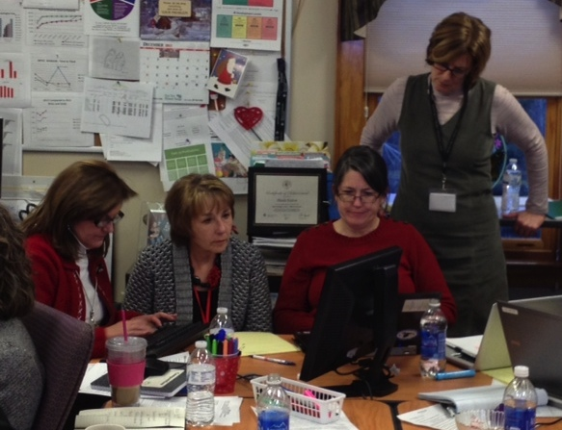
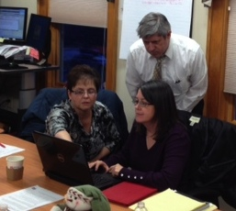
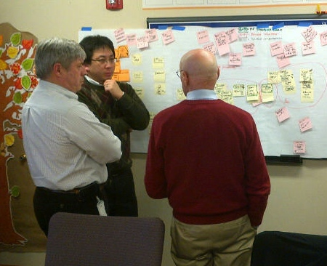
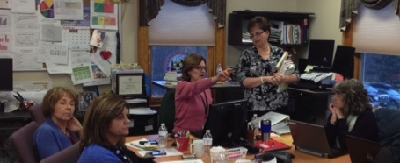
Team at Work

Slide 39
Metrics and Leading Indicators
Metrics:
  Bridges to excellence/NCQA measures
  Revenue/Provider
  RVU/Provider
  Patient satisfaction
  Staff/Provider Satisfaction

Slide 40
Next Steps
What | Who | By when
Complete KPS sheets |  | Jan 8
Clean up and post final report out to compass & huddle | Terry | Jan 10
Schedule follow on meeting to review ROI approach | Terry | TBD
Follow on implementation work for Bangor | Linda T | TBD
Deploy selection criteria Select and collect appropriate metrics/leading indicators PDSA
Fold athena related questions into the athena project | Terry | Jan
Follow up w/HR regarding implications of ‘pop health’ titles vs ‘specialty nurse’ titles/qualifications | Ellen | TBD
Coordinate ICD9 Coding for Specialty nurses | Ellen | TBD
HIN: coordinate access for other sites and follow up on advancements/training in January | Paula | TBD

Slide 41
Lessons Learned
I had a chance to see the numbers (quality, cost, patient satisfaction)
How bright this team is
How intense these MPMS events can be
We have fun…
Collaborative care is a process
This was an eye opener … Seeing how 1 hr of RN and 1hr of Provider time makes sense was key (how the RN investment pays off downstream in the visit (RVU, Capacity, quality)..)
I had a better understanding of the financial impact of the Collaborative care approach (I always knew, but now I can see the pieces)
Health InfoNet is a MUST have
It really is about the relationships (Providers→team, RN→Patient)
This model give us the opportunity to care for the whole patient
Theses events are exhausting and tired
I learned what and “FFH” is … also where in Maine the “williwhacks” are
Beyond the event … the power of a high functioning team is amazing (high performing teams create energy)
I thought I knew how the Collaborative Care model worked, but I learned a new way to see our value
The resources that MP can bring is exciting

Slide 42
Appendix

